Slide 1

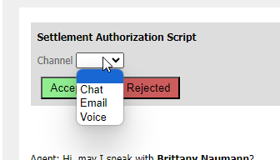
Authorizing Settlements (updated 7/27/23)
Whenever you see this alert at the top of the page :
Click hyperlink
Click “Authorization script”
Review settlement with client
If client agrees –
Record authorization
Select which channel the authorization was completed through: Chat, Email or Voice (for calls) then click accept
Upload REC authorization to client file; save file name with the following information.
Client Last Name, Global Auth, Creditor, Todays Date
Leave notes in comment section
If client rejects –
Attempt rebuttal
Click reject & select which channel the authorization was completed: Chat, Email or Voice (for calls)
Record clients rejection by using option 9
Leave notes in comment section
Upload recording to client files using the following info:
Client Last Name, Global Auth Rejection , Creditor, Todays Date
Notes:
Enrollments were down to $61MM in December from $81MM in November
Internal (non-affiliate) enrollments of $46MM were 23% below forecast ($60MM)
Drivers include macro factors: holiday seasonality, covid increases, stimulus allowing customers to put off decisions
Internally we are observing it is harder to reach customers, lower P2 rates, and lower close rates

Slide 2
Authorizing Settlements (updated 7/27/23)
Whenever you see this alert at the top of the page :
Click hyperlink
Click “Authorization script”
Review settlement with client
If client agrees –
Record authorization
Select which channel the authorization was completed through: Chat, Email or Voice (for calls) then click accept
Upload REC authorization to client file; save file name with the following information.
Client Last Name, Global Auth, Creditor, Todays Date
Leave notes in comment section
If client rejects –
Attempt rebuttal
Click reject & select which channel the authorization was completed: Chat, Email or Voice (for calls)
Record clients rejection by using option 9
Leave notes in comment section
Upload recording to client files using the following info:
Client Last Name, Global Auth Rejection , Creditor, Todays Date
Notes:
Enrollments were down to $61MM in December from $81MM in November
Internal (non-affiliate) enrollments of $46MM were 23% below forecast ($60MM)
Drivers include macro factors: holiday seasonality, covid increases, stimulus allowing customers to put off decisions
Internally we are observing it is harder to reach customers, lower P2 rates, and lower close rates

Slide 3
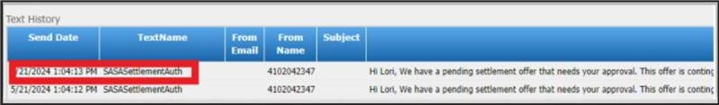
Pre - Settlements (updated 06/11/24)
Text message communications are sent to clients who have received a settlement offer and are currently awaiting the settlement letter. Clients can now pre-authorize the settlement using a link sent to them via text. We will not see the settlement as pending; instead, direct them back to the original text message they received and ask them to click on the link and follow the instructions to authorize the pre-settlement.
Talking Points: "(client name) I see that we have sent you a text message to advise you of a settlement offer that needs your approval. At this time in order to approve your settlement offer, we will need you to click on the link within the message and it will provide you the details of the settlement we have in place for you."
Agent Steps to take action:
1) Always look in the contact history >Client page < Comment tab| Scroll down and you will see the contact history
2) Under text history see if you see "SASASettlementAuth" - we need to ask the client to follow the link in order to see auth details and accept.
3) Direct the client back to the text message and asked them to click on the link to authorize the settlement.
Notes:
Enrollments were down to $61MM in December from $81MM in November
Internal (non-affiliate) enrollments of $46MM were 23% below forecast ($60MM)
Drivers include macro factors: holiday seasonality, covid increases, stimulus allowing customers to put off decisions
Internally we are observing it is harder to reach customers, lower P2 rates, and lower close rates

